Slide 1
Web Scraping
Presented by:
Dipali Ziman

Slide 2
content
What is scraping
Why we scrape
My experiments with web scraping
How do we do it
Tools to use
Online demo

Slide 3
Scraping
converting unstructured documents into structured information scraping:

Slide 4
What is Web Scraping?
Web scraping (web harvesting) is a software technique of extracting information from websites
It focuses on transformation of unstructured data on the web (typically HTML), into structured data that can be stored and analyzed

Slide 5
Why we scrape?
Web pages contain wealth of information (in text form), designed mostly for human consumption
Static websites (legacy systems)
Interfacing with 3rd party with no API access
Websites are more important than API’s
The data is already available (in the form of web pages)

Slide 6
My Experiments with Scraping

Slide 7
Getting started!

Slide 8
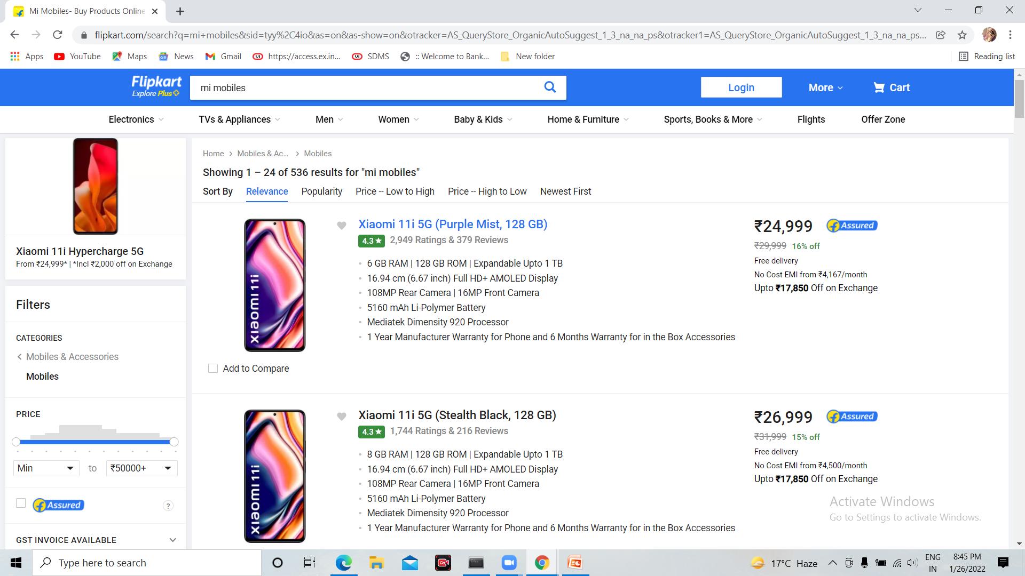
Flipkart mobile data

Slide 9
Fetching the data
Involves finding the endpoint - URL or URL’s
Sending HTTP requests to the server
Using requests library: import requests data = requests.get(‘http://google.com/’) html = data.content

